Slide 1
Hacker Techniques, Tools, and Incident Handling
Chapter 3
Cryptographic Concepts

Slide 2
Learning Objective
Describe cryptology.

Slide 3
Key Concepts
Encryption and its uses in modern computer systems
Strong and weak cryptosystems
Cryptanalysis and cryptanalysis tools

Slide 4
Cryptographic Basics
Cryptography provides:
  A means to safeguard information against unauthorized disclosure
  A means to detect modification of information
  Confidentiality, integrity and nonrepudiation
Notes:
The cipher, called a “shift cipher,” works by substituting each character in a message with the character a certain number of positions to the left or right of the current character. This is called “shifting” the character.
Shift ciphers substitute message characters with a certain number of positions either to the right or left of current character.

Slide 5
Cryptographic Basics (Cont.)
Common Terms
  Code: A mechanism that relies on the usage of complete words or phrases
  Cipher: Utilizes single letters to perform encryption
Examples: Substitution (Caesar cipher), transposition, stream, block

Slide 6
Authentication
Identifies a party as a user, computer or service
Plays a vital role in system stability
Validates message comes from known and trusted source
Unauthenticated messages aren’t accepted as genuine

Slide 7
Networking Protocols That Use Encryption
IPv6
IPSec
SNMPv2 +
SSL
TLS
SSH
Common VPN protocols
Notes:
Internet Protocol Version 6 (IPv6) uses encryption to authenticate, validate, and protect sensitive traffic
IP Security (IPSec) is an IPv6 component used in virtual private networks (VPNs); the feature is option in IPv4
Simple Network Management Protocol (SNMP) v2 and higher
Secure Sockets Layer (SSL), which makes extensive use of cryptography
Transport Layer Security (TLS), the successor to SSL
Secure Shell (SSH), a replacement for some older protocols

Slide 8
Integrity
Ability to verify information:
Has not been altered
Remains in original form
Helps to detect changes to data
Does not preserve data confidentiality

Slide 9
Nonrepudiation
Digital certificates
Message authentication codes (MACs)
Digital signatures
Digital certificates
IPSec
Notes:
Nonrepudiation is commonly used in messaging and email systems.

Slide 10
Symmetric and Asymmetric Cryptography
Symmetric
Asymmetric
Requires two keys – one public and one private
Uses single shared key for encrypting and decrypting data

Slide 11
Cryptographic History
Egyptian hieroglyphics
Scytale
Caesar cipher
Polyalphabetic cipher (Vigenère cipher)
Enigma
JN-25
Concealment cipher
One-time pad
Notes:
Egyptian hieroglyphics — A great example of substitution ciphers
Scytale — Used by Spartans; the message was written lengthwise and then wrapped around a rod of predetermined diameter to decipher
Caesar cipher — A type of substitution cipher
Polyalphabetic cipher — A substitution cipher that uses multiple substitution alphabets
Enigma — An electromechanical rotor machine used by the Germans in WWII for encryption and decryption of classified messages
JN-25 — An encryption process used by the Japanese in WWII
Concealment cipher — The message is present but concealed in some manner
One-time pad — Uses a large repeating key where each cipher key character is used one and then destroyed; used for sensitive communications such as diplomatic cables

Slide 12

Cryptographic History (Cont.)
Caesar Cipher

Slide 13

Cryptographic History (Cont.)
Polyalphabetic Cipher

Slide 14
Cryptograph History (Cont.)
How cryptography provides information security:
Confidentiality ensures only authorized subjects access data
Authenticity ensures that a piece of data can be verified as being valid and can be trusted
Integrity allows for detection of alterations in information through hashing
Nonrepudiation is positive proof that a message or action originated with a certain party

Slide 15
What Is an Algorithm or Cipher?
Terms used interchangeably
Describes the formula or process used to perform encryption
Cryptographic algorithms are based on math
Basic operation is the exclusive or (XOR) operator
XOR is a bitwise operator that returns a true value when the values of the input bits differ and a value of false when the input bits are the same

Slide 16
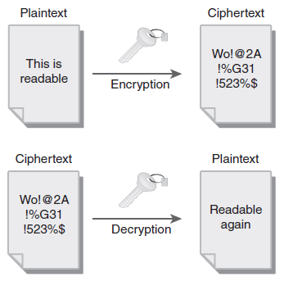
Symmetric Encryption
Notes:
Symmetric encryption uses the same key to encrypt an decrypt data.
Unencrypted data is referred to as plaintext or cleartext.
Encrypted data is known as ciphertext and cannot be understood without the correct encryption algorithm and proper key.
Keys are used to determine encryption settings.
Algorithm quality determines the effectiveness of the encryption process.

Slide 17
Symmetric Encryption (Cont.)
Uses shared key
Examples:
  3DES (Triple DES)
  Advanced Encryption Standard (AES)
  Blowfish
  International Data Encryption Algorithm (IDEA)
  RC4, RC5, and RC6
  Skipjack

Slide 18
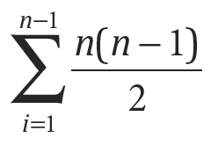
Symmetric Encryption (Cont.)
Each pair of users share a unique key
The number of key pairs increases rapidly
For n users, the number of key pairs is represented by the sum of all of the numbers from 1 to (n−1)

Slide 19
Symmetric Encryption (Cont.)
Key management:
Keys should be stored and transmitted by secure means to avoid interception.
Keys should be generated by a pseudorandom process.
The key’s lifetime should correspond with the sensitivity of the data it is protecting.
Keys should be properly destroyed when the process for which they were used has lapsed.

Slide 20
Asymmetric Encryption
Also called public key cryptography
Uses public and private keys
Everyone generally has access to public key
Can use public key to encrypt data, or validate or reverse operations performed by private key
Only holder of corresponding private key can decrypt data
If holder of private key encrypts something with private key, anyone with access to public key can decrypt it

Slide 21
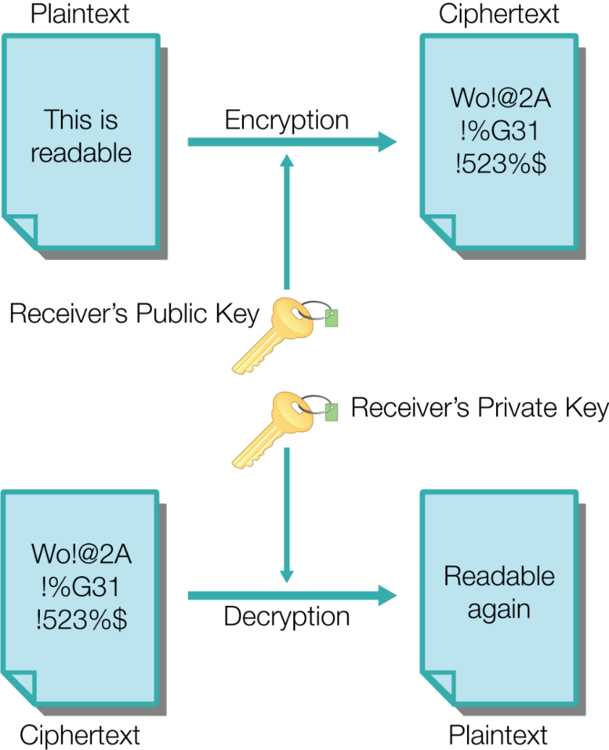
Asymmetric Encryption (Cont.): Decryption Process

Slide 22
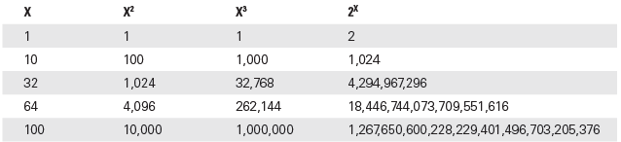
Asymmetric Encryption (Cont.)
Comparison of polynomial-time
and NP-hard problems

Slide 23
Asymmetric Algorithms (Cont.)
Diffie-Hellman
El Gamal
RSA (Rivest-Shamir-Adleman)
Elliptic Curve Cryptography (ECC)
Notes:
Diffie-Hellman — A process to establish and exchange asymmetric keys over insecure mediums
El Gamal — A hybrid algorithm using asymmetric key to encrypt the symmetric key, which is then used to encrypt the rest of the message
RSA — Released in 1977, RSA is used in e-commerce and comparable applications
Elliptic curve cryptography (ECC) — A computationally intensive algorithm based on solving the elliptic curve discrete logarithm problem

Slide 24
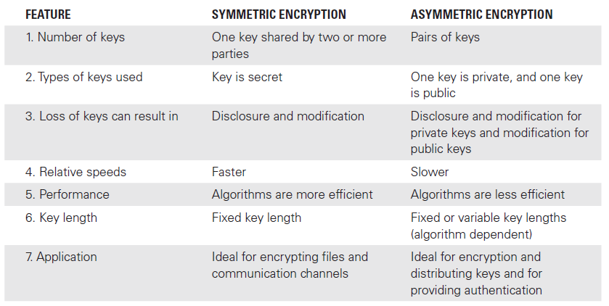
Comparison of Asymmetric and Symmetric Encryption

Slide 25
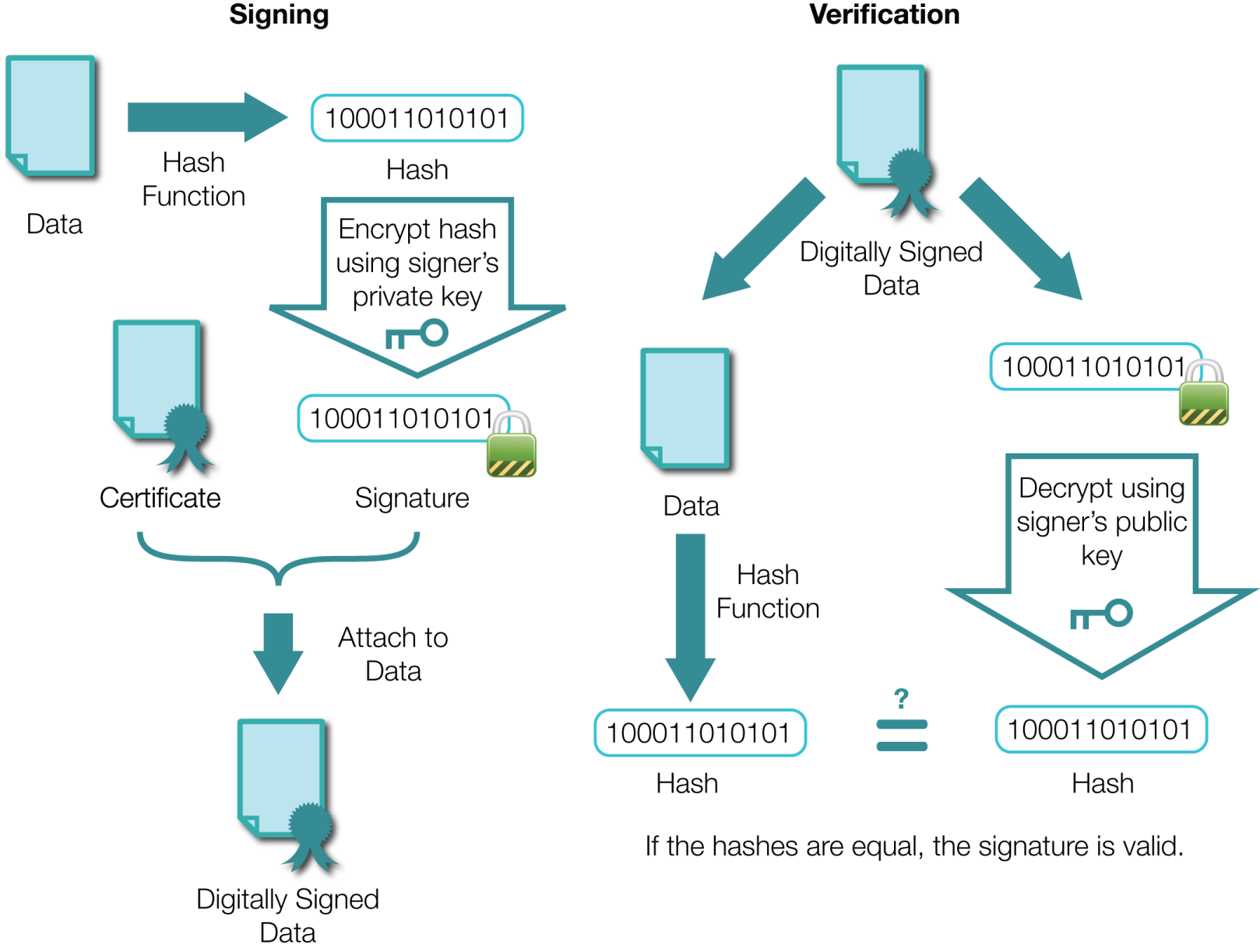
Digital Signatures
Notes:
Digital signatures combine public key cryptography and hashing.
Creating a digital signature of existing data requires two main steps:
1. The message or information to be sent is passed through a hashing algorithm that creates a hash to verify the integrity of the message.
2. The hash is passed through the encryption process using the sender’s private key as the key in the encryption process.
The sender then sends the signature along with the original unencrypted message to a recipient who can reverse the process.
When the receiver receives the message with the signature, that receiver will first validate the identity of the sender and then retrieve the public key to decrypt the signature.
Once the signature is decrypted, the resulting cleartext is actually the message hash from the
sender.
Then, the receiver will run the same hashing algorithm to generate a local hash of the received message.
Then, the hashes, both the original and the one newly created, should match.
If they do not, the message has been altered because the sender calculated the hash.
If the hash values do match, the message has been proven to come from the stated sender and has not been altered.

Slide 26
Purpose of Public Key Infrastructure (PKI)
Provides a mechanism through which two parties can establish a trusted relationship even if the parties have no prior knowledge of one another
PKI brings trust, integrity, and security to electronic transactions
PKI framework used to manage, create, store, and distribute keys and digital certificates

Slide 27
Components of PKI Framework
Certificate authority (CA)
Registration authority (RA)
Certificate revocation list (CRL)
Certificate distribution system
Digital certificate

Slide 28
The Role of Certificate Authorities (CAs)
Root CA
Initiates all trust paths
Peer CA
Self-signed certificate distributed to certificate holders
Principal CA for its domain
Subordinate CA
A certificate authority that does not begin trust paths
Also known as a child path

Slide 29
The Role of Certificate Authorities (CAs) (Cont.)
Registration authority
  Cannot issue a certificate
  Accepts requests
  Verifies identities
  Passes information to the CA to generate certificates
Certificate revocation list (CRL)
  A list of certificates that have been revoked because it can no longer be trusted

Slide 30
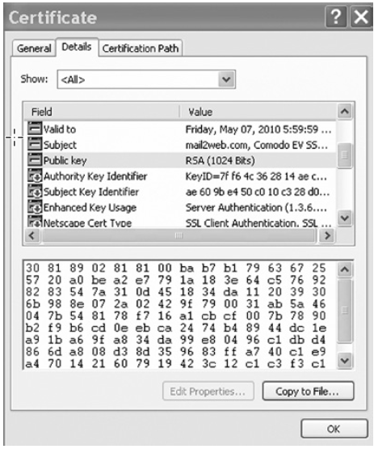
Digital Certificates
Notes:
To ensure compatibility between CAs, digital certificates are commonly built and formatted using the X.509 standard.

Slide 31
PKI Attacks
Sabotage
Communications disruption/
modification
Design and implementation flaws
Operator error
Operator impersonation
Coercion/social engineering
Notes:
Sabotage — The PKI components or hardware may be subjected to a number of attacks, including vandalism, theft, hardware modification, and insertion of malicious code. Most attacks are designed to cause denial of service (DoS).
Communications disruption/modification — These attacks target communications between the subscribers and the PKI components. The disruption could cause DoS but may also be used by the attacker to mount additional attacks, such as impersonation of a subscriber or the insertion of fake information.
Design and implementation flaws — These attacks target flaws in the software or hardware on which the subscriber depends to generate or store key material and certificates. The attacks can result in malfunctions of the software or hardware that may cause DoS.
Operator error — These attacks target improper use of the PKI software or hardware by the operators and may result in DoS or the disclosure or modification of subscriber keys and certificates.
Operator impersonation — These attacks target the user by impersonating a legitimate PKI operator. As an operator, the attacker could do almost anything a legitimate operator could do, including generate keys, issue certificates, revoke certificates, and modify data.
Coercion/social engineering — These attacks occur when the administrator or operator of a CA is induced into giving up some control over the CA or creating keys and certificates under duress or trickery.

Slide 32
Hashing
Designed to provide a unique data fingerprint that changes dramatically in the event of data alteration or tampering
One-way hashing function in cryptography is responsible for integrity
  Also known as a fingerprint
Hashes:
Are not used for encryption
Are used for authentication and ensuring integrity

Slide 33
Common Hashing Algorithms
Message Digest 2 (MD2)
Message Digest 4 (MD4)
Message Digest 5 (MD5)
HAVAL
Secure Hash Algorithm-0/1 (SHA-0/1)
Secure Hash Algorithm-2 (SHA-2)
Secure Hash Algorithm-3 (SHA-3)
Notes:
Message Digest 2 (MD2) — An older one-way hash function used in the privacy-enhanced mail (PEM) protocols along with MD5. It produces a 128-bit hash value for an arbitrary input. It is similar in structure to MD4 and MD5 but is slower and less secure.
Message Digest 4 (MD4) — A one-way hash function that provides a 128-bit hash of the input message. Although faster and more secure than MD2, it also has been shown to contain vulnerabilities.
Message Digest 5 (MD5) — An improved and redesigned version of MD4, producing a 128-bit hash. MD5 is the most common cryptographic hashing algorithm in current use.
HAVAL — A variable-length, one-way hash function and modification of MD5. HAVAL processes the messages in blocks of 1,024 bits, twice that of MD5, and is faster than MD5.
Secure Hash Algorithm-0/1 (SHA-0/1) — Provides a 160-bit fingerprint. SHA-0 and SHA-1 are no longer considered secure and are vulnerable to attacks.
Secure Hash Algorithm-2 (SHA-2) — A group of SHA algorithms that each processes messages up to 512-bit blocks and adds padding if needed to get the data to added up to the right number of bits. SHA also includes other versions, including SHA-256 and SHA-512, which are part of the SHA-2 group.
Secure Hash Algorithm-3 (SHA-3) — Formally known as Keccak, this algorithm was selected in 2012 as the NIST SHA-3 standard. It supports the same key lengths as SHA-2 but is far more secure.

Slide 34
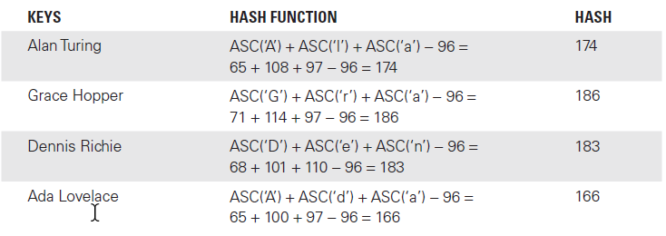
The Hashing Process

Slide 35
Common Cryptographic Systems
Secure Shell (SSH)
Secure Sockets Layer (SSL)
Transport Layer Security (TLS)
IP Security (IPSec)
Password Authentication Protocol (PAP)
Challenge Handshake Authentication Protocol (CHAP)
Point-to-Point Tunneling Protocol (PPTP)
Layer 2 Tunneling Protocol (L2TP)
Secure Sockets Tunneling Protocol (SSTP)
Notes:
Secure Shell (SSH) — Provides secure remote access
Secure Sockets Layer (SSL) — Transmits information securely over the Internet
Transport Layer Security (TLS) — A successor to SSL; encrypts communications between host and client
IP Security (IPSec) — An end-to-end security technology that allows two devices to communicate securely
Password Authentication Protocol (PAP) — Used for authentication but is not secure
Challenge Handshake Authentication Protocol (CHAP) — More secure than PAP; uses a hashed value that is valid for only single logon transactions
Point-to-Point Tunneling Protocol (PPTP) — Composed of two components: 1) the transport that maintains virtual connections; and 2) the encryption that ensures confidentiality
Layer 2 Tunneling Protocol (L2TP) — Used to transfer data over VPNs; implements encryption with IPSec
Secure Sockets Tunneling Protocol (SSTP) — Uses SSL to set up a secure VPN communication channel

Slide 36
Cryptanalysis
Ciphertext-only attack
Known plaintext attack
Chosen plaintext attack
Chosen ciphertext attack
Notes:
Ciphertext-only attack — An attacker has some sample of ciphertext but lacks the corresponding plaintext or the key. The goal is to find the corresponding plaintext to determine how the mechanism works. Ciphertext-only attacks tend to be the least successful because the attacker has very limited knowledge at the outset.
Known plaintext attack — The attacker possesses the plaintext and ciphertext of one or more messages. The attacker will then use this acquired information to determine the key in use. In reality, this attack shares many similarities with brute-force attacks.
Chosen plaintext attack — The attacker can generate the corresponding ciphertext to the deliberately chosen plaintext. Essentially, the attacker can “feed” information into the encryption system and observe the output. The attacker may not know the algorithm or the secret key in use.
Chosen ciphertext attack — The attacker can decrypt a deliberately chosen ciphertext into the corresponding plaintext. Essentially, the attacker can “feed” information into the decryption system and observe the output. The attacker may not know the algorithm or the secret key in use. A more advanced version of this attack is the adaptive chosen ciphertext attack (ACCA) in which the selection of the ciphertext is changed based on results.

Slide 37
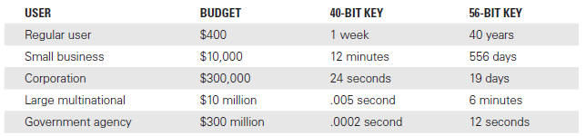
Cryptoanalysis (Cont.)
Cryptographic cracking times for DES using different key lengths

Slide 38
Cryptanalysis (Cont.)
Replay attack
  Records and retransmits packets on the network
  Threat to applications that require sequence authentication
  Similar to a man-in-the-middle (MitM) attack
Social engineering attacks

Slide 39
Cryptanalysis (Cont.)
Threat to passwords
  Dictionary password attack
  Comparative analysis
  Rainbow tables
  Brute-force password attack
  Hybrid attack
Notes:
A dictionary attack uses software with a dictionary list, which contains long lists of various words that have been predefined and can be quickly downloaded for use.
If hashing is used to store passwords, it is possible to thwart it by using an attack technique commonly known as comparative analysis.
Each possible dictionary word is hashed and then compared with the encrypted password.
Once a match is found, the password is discovered.
If a match is not found, the process repeats until termination or a subsequent match is found.
Rainbow tables are tables of prehashed values, often from dictionaries. Attackers can use rainbow tables to look up hashed values instead of having to hash each potential password in real time.
Brute-force, password-cracking programs employ a simple, low-tech approach to breaking passwords by attempting every possible combination of characters in varying lengths.
Brute-force attacks will eventually be successful given enough time but can take millions of years.
Brute-force attacks can be more effective if many computers are used in parallel.

Slide 40
Future Forms of Cryptography
Identity-Based Encryption (IBE)
  Derives encryption keys from a user’s identity
Attribute-Based Encryption (ABE)
  Derives encryption keys based on descriptive attributes
Location or Position-Based Encryption
  Derives encryption keys based on position or location
Quantum cryptography
  Uses quantum mechanics to generate random encryption keys and exchange them securely

Slide 41
Summary
Encryption and its uses in modern computer systems
Strong and weak cryptosystems
Cryptanalysis and cryptanalysis tools

